Slide 1
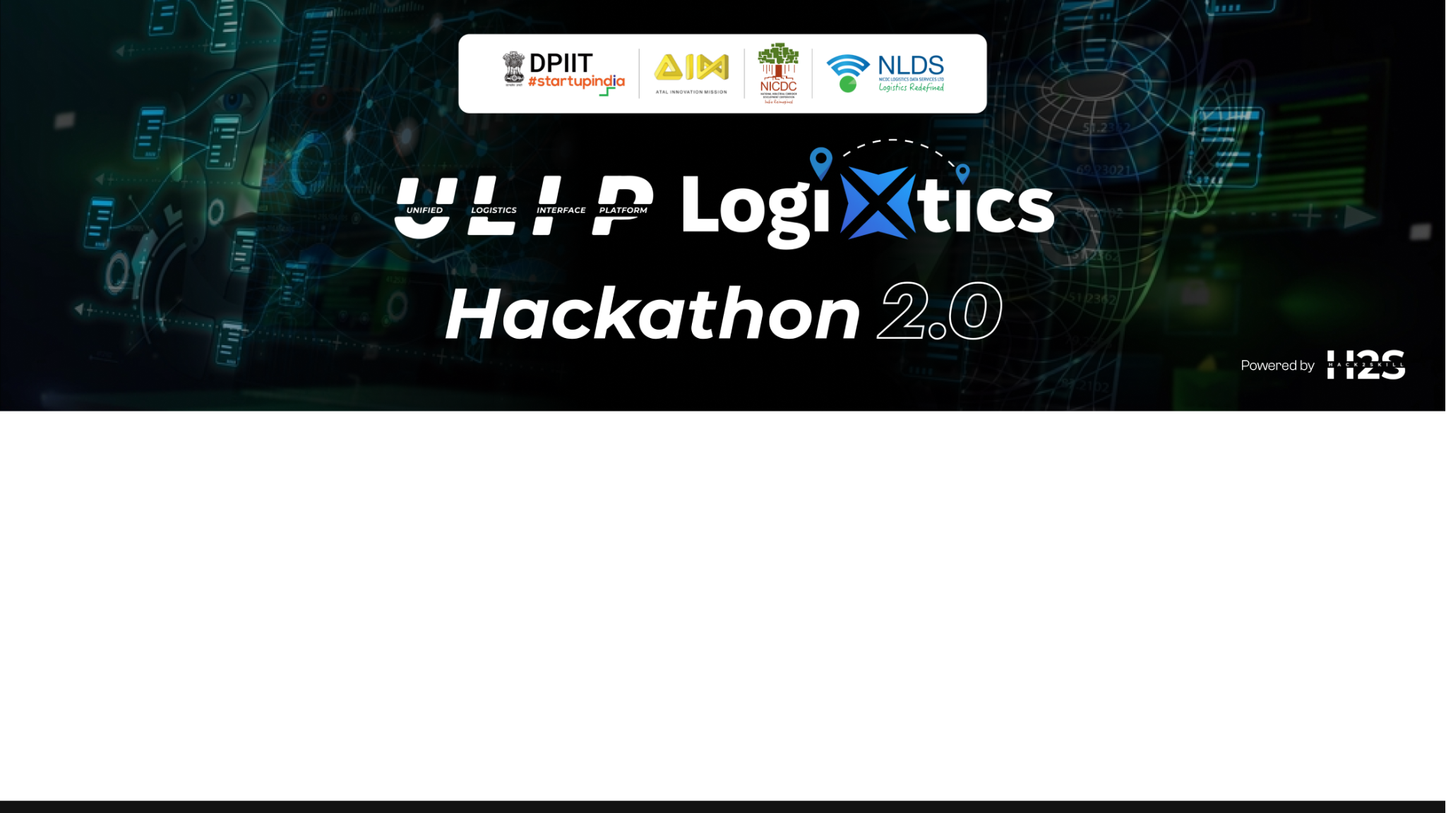
Team Details
Team name: Overt Ideas and Solutions
Team leader name: Chandan G C
Problem Statement: Data-Driven Optimization of Logistics Operations

Slide 2
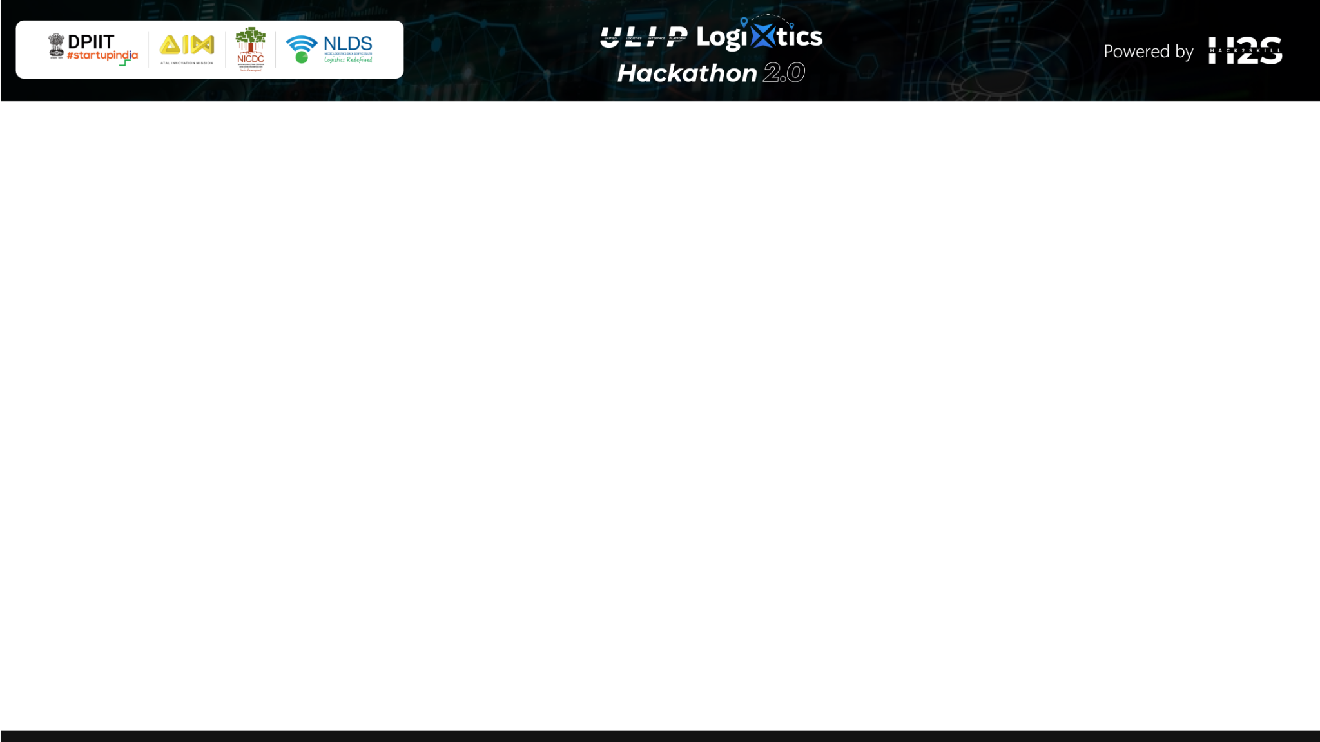
Brief about the idea
Our solution focuses on using data analytics and machine learning to optimize logistics operations and improve decision-making throughout the supply chain. By analyzing historical data, companies can streamline processes like route optimization, demand forecasting, and resource allocation.
The goal is to enhance efficiency, reduce costs, and enable data-driven decision-making, all while maintaining flexibility to adapt to evolving logistics challenges through continuous improvement based on historical trends. Implement graphical representations to understand the data better and make informed decisions with data analysis.
The data consists of historical records relevant to logistics operations, encompassing aspects like shipment routes, delivery times, inventory levels, and demand fluctuations. This comprehensive dataset allows for a nuanced analysis that aims to enhance efficiency, optimize routes, and forecast demand. By leveraging this data, companies can gain valuable insights to improve decision-making, reduce costs, and maintain operational flexibility. The data also supports the continuous improvement of logistics strategies through trend analysis and machine learning algorithms, enabling a more responsive and adaptive supply chain management system.

Slide 3
Opportunities
How different is it from any of the other existing ideas?
While traditional systems might rely solely on historical data or real-time tracking, our approach leverages the capabilities of models like ChatGPT and Gemini to not just track, but also interpret and optimize logistics operations.
Automated recommendations and classifications, allowing logistics managers to directly receive actionable insights and suggested optimizations rather than having to manually interpret complex data reports.
Advanced visualization: Most current logistics tools focus on raw data or simple dashboards. This solution incorporates graphical representations, such as predictive analytics visuals and real-time progress overviews, making data easier to understand and act upon.

Slide 4
GenAI Integration: Seamless integration of generative AI models with real-time shipment tracking and comprehensive data analytics.Supply Chain Transparency. Imagine being able to see every step of a product's journey, from raw materials to the end consumer.Optimisation algorithms can pinpoint inefficiencies and recommend improvements, while data analytics can predict potential bottlenecks before they occur.
Route Optimization: Leveraging real-time traffic data, weather forecasts, and delivery schedules, route optimisation algorithms can chart the most efficient paths for delivery vehicles, reducing fuel consumption and improving delivery times.
Load Balancing: Data-driven load balancing can optimise the distribution of goods across different transportation modes and vehicles, ensuring that space is used efficiently and costs are minimised.

Slide 5
Opportunities
How will it be able to solve the problem?
Extracting refined data that highlights the most critical factors affecting logistics (e.g., bottlenecks, high-cost routes).
Providing recommendations based on patterns observed in the data, helping optimize routes, resource allocation, and inventory.
Classifying data as per logistics requirements, such as categorizing deliveries by priority or classifying drivers by performance, to streamline operations, which enable companies to optimize routes, predict demand, and allocate resources more efficiently.
Graphical representations further support decision-making, offering a visual grasp of logistics performance and predictions.

Slide 6
Opportunities
USP of the proposed solution
The unique selling point (USP) of the proposed solution is its seamless integration of generative AI models with real-time shipment tracking and comprehensive data analytics.
Generative AI Integration: The use of ChatGPT and Gemini for data analysis, recommendations, and classification sets this solution apart by offering advanced, automated insights that go beyond standard logistics software.
Comprehensive Optimization: By blending machine learning and data analytics with generative models, the solution provides a more holistic approach to logistics, not only optimizing operations but also guiding decisions with AI-generated insights.
Enhanced Usability: Visual data representations allow decision-makers to quickly understand trends and make informed choices, improving the overall user experience and the ability to respond proactively to logistics challenges.

Slide 7
List of features offered by the solution
Generative AI-Driven Summaries: Automatically summarize large volumes of logistics data (e.g., delivery reports, route data) to provide concise overviews of operational performance.
Key Data Extraction and Demand Prediction: Extract refined, essential data such as top delivery bottlenecks, high-cost areas, and underperforming routes to help focus on critical improvements.
Automated Recommendations: Generate recommendations for route optimization, resource allocation, and demand forecasting based on historical data and AI-driven insights.
Data Classification: Classify logistics data (e.g., delivery priorities, driver performance, and shipment types) to streamline decision-making and resource management.
Graphical Data Representation:Visualize logistics data through charts, graphs, and other graphical representations to simplify understanding of complex datasets and trends.

Slide 8
List of features offered by the solution
Predictive Analytics: Analyzes historical and real-time data to forecast demand accurately, allowing for optimized resource allocation and planning.
Logistics Cost Optimization: Provide insights into cost reduction opportunities such as fuel consumption, route efficiencies, and fleet utilization without the need for real-time tracking.
Enhanced Data Integration: Seamlessly integrate and standardize data from diverse sources, creating a unified dataset for better analysis.
Customizable Reports: Generate tailored reports with a focus on specific areas of interest, such as performance metrics for individual drivers or warehouses.
Real-Time Tracking: Enables users to monitor shipments in real-time, ensuring up-to-date visibility of logistics operations.

Slide 9
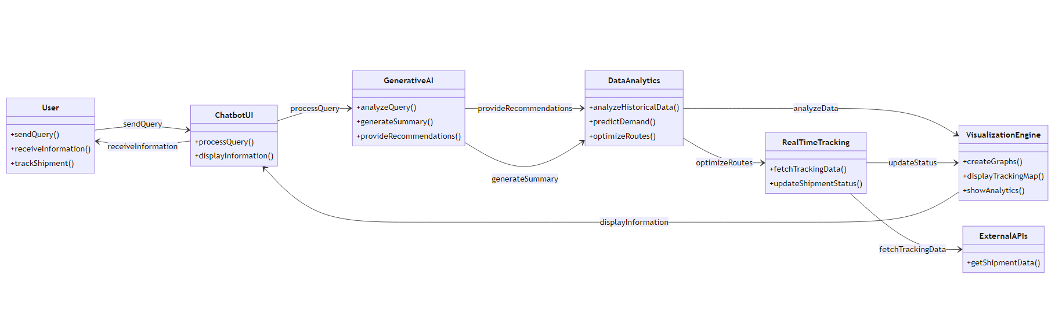
Process flow diagram or Use-case diagram

Slide 10
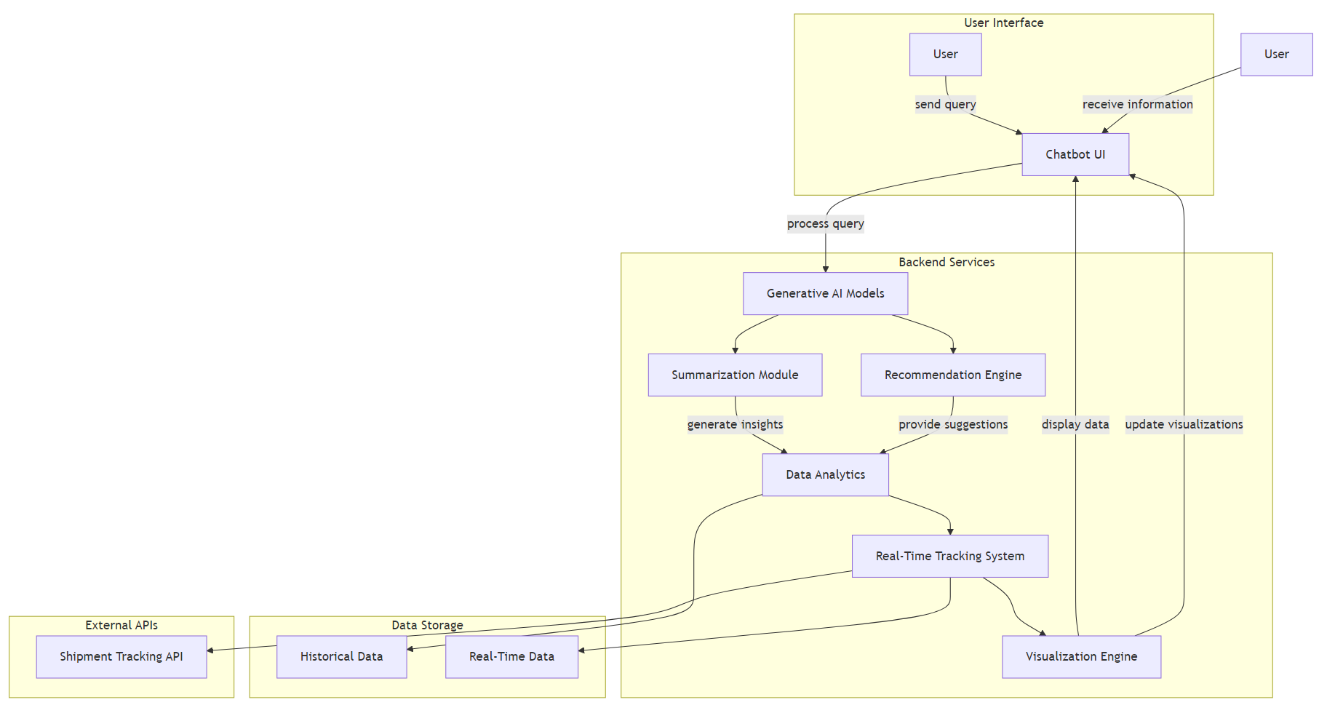
Architecture diagram of the proposed solution

Slide 11
Technologies to be used in the solution
Frontend Technologies: Flutter for building a cross-platform mobile application that offers a seamless user interface and experience for accessing logistics data and insights.
Backend Technologies: Python as the primary programming language for developing backend services, including APIs and data processing modules.
Generative AI and Machine Learning Models:
Gemini: For advanced data analysis, predictions, and generating recommendations in logistics operations.
GPT-4.0: To facilitate natural language processing tasks such as summarizing data, extracting insights, and classifying information.
Database Technologies: SQL for structured data storage and management, enabling efficient data retrieval and analysis for logistics operations based on datasets.
FastAPI: For developing RESTful APIs to facilitate communication between the Flutter frontend and Python backend, ensuring smooth data flow and integration.

Slide 12
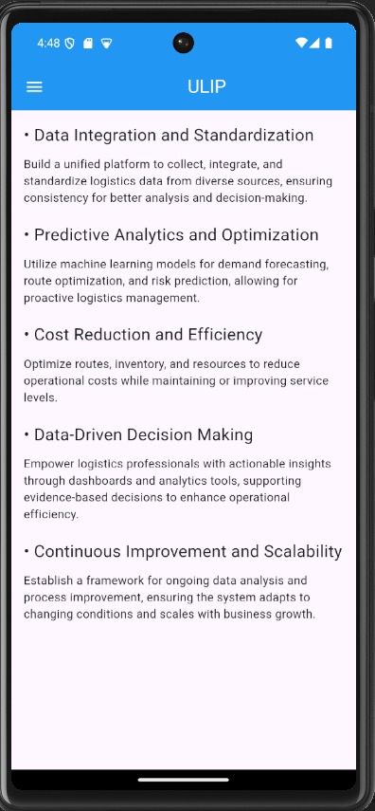
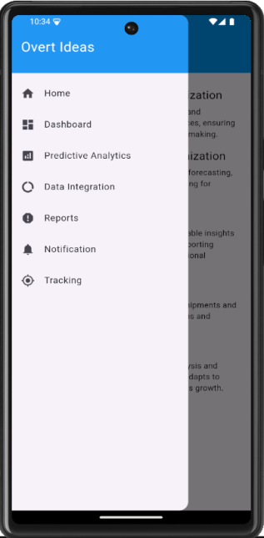
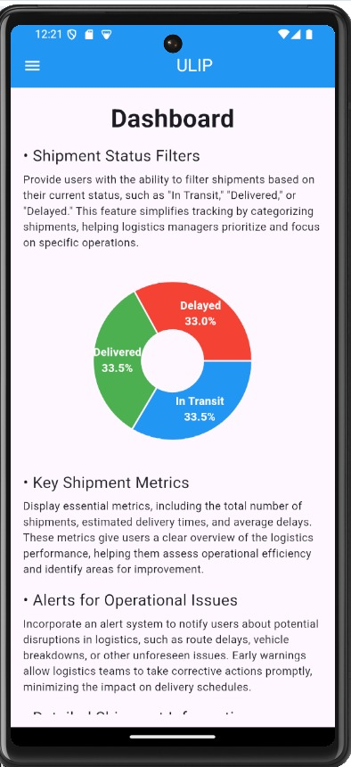
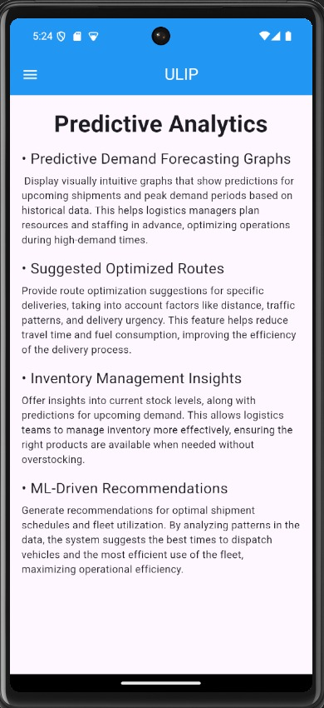
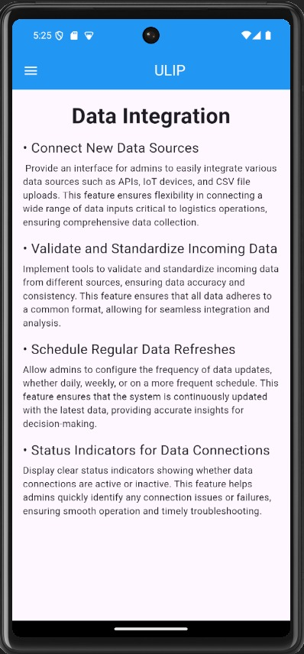
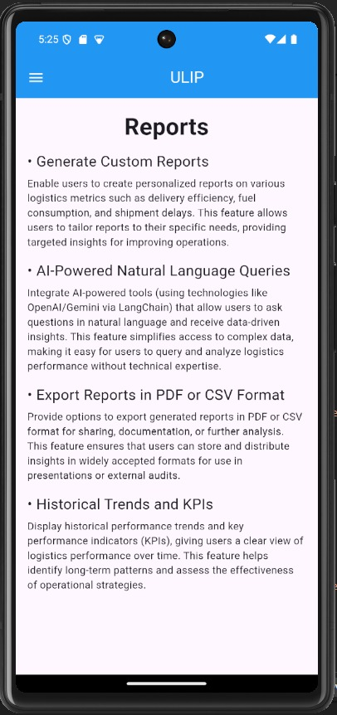
Snapshots of the prototype

Slide 13
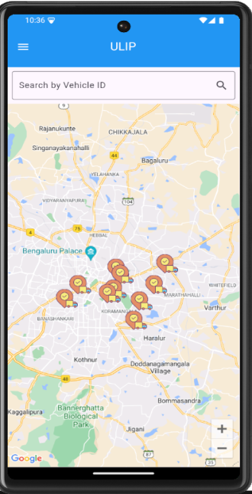
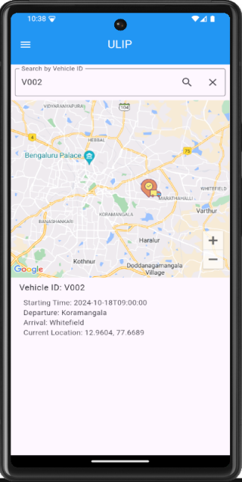
For real-time tracking, the app will display a live Google Map showing the vehicle's current location, the route, and estimated time of arrival (ETA), along with details like the start time, distance covered, and time remaining.
AI-driven analytics will provide real-time insights, such as the driver’s speed, fuel efficiency, and an on-time prediction percentage based on past performance.
The system will monitor road conditions, alert users to any traffic or roadblocks, and calculate delays accordingly. All this data will be overlaid on the map for a comprehensive, real-time view of logistics operations.

Slide 14
Prototype Performance report/Benchmarking
Response Time: Aim for an average response time that ensures quick interactions, enhancing user experience.
Throughput: Design the system to handle a significant number of requests per second to accommodate peak usage.
Resource Utilization: Ensure efficient use of CPU and memory resources to maintain optimal performance during testing.
Prediction Accuracy: Strive for high accuracy in demand forecasting and route optimization with Generative AI models.
User Experience: Focus on achieving strong user satisfaction regarding interface responsiveness and overall usability.

Slide 15
Additional Details/Future Development
Enhanced AI Capabilities: Plan to integrate more advanced AI features, such as natural language processing for better customer interactions and automated decision-making based on predictive analytics.
Scalability Improvements: Develop the architecture to support scaling, allowing the application to handle increased data loads and user requests as the business grows.
Integration with External Systems: Future updates will focus on seamless integration with third-party logistics providers and existing enterprise systems for comprehensive data sharing.
User Feedback Incorporation: Establish a feedback loop for continuous improvement, ensuring that user insights inform future updates and feature enhancements.
Data Security Enhancements: Implement robust security measures and compliance protocols to safeguard sensitive data and ensure user privacy as the platform evolves.

Slide 16
Provide links to your:
GitHub Public Repository : https://github.com/ChiraagPVovert/ULIP_APP
Demo Video Link (3 Minutes):
Final Product Link:

Slide 17
